Slide 1
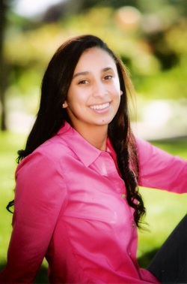
Megan Salinas
LHS Class of 2014

Slide 2
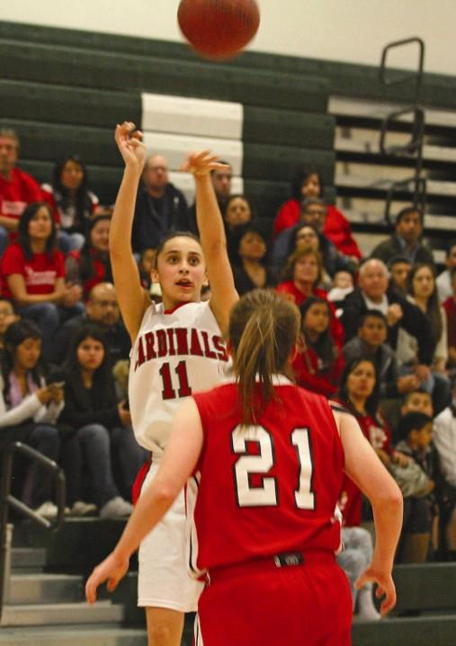
Who am I?
I was born and raised in Lindsay
Father, Mother and my older Brother
Selected as one of Lindsay’s Youth of the Year for 2013
My interests: athletics, education and helping others
Hobbies: sports, spending time with friends and family, and relaxing
Sports: Varsity Basketball and Swimming all 4 years
Clubs and Organizations: AVID, Key Club, National Spanish Honors Society, Cardinal Letter Club

Slide 3
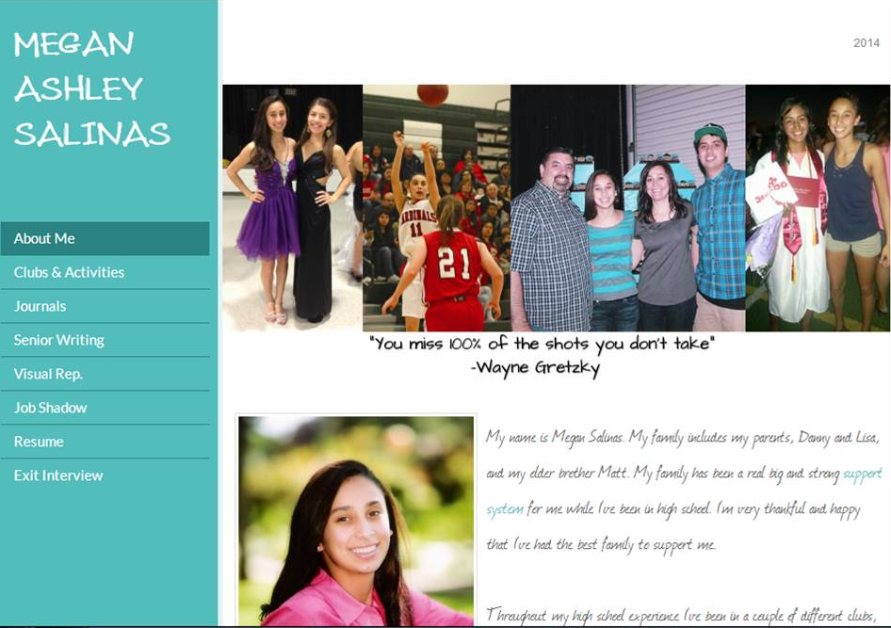
Senior Project
- Journals - Visual Representation
- Job Shadow - Senior Writing

Slide 4
Journals
The most meaningful month of my senior year so far has been October. October was the most important month as well because it was when all colleges opened their applications and were allowing high school seniors to submit their applications. For every high school senior that was a huge step in their senior year and that’s why October was the most meaningful month for me so far.
My biggest challenge this year so far has to be that I am taking AP Biology. My greatest accomplishment has been successfully submitting my applications to colleges and knowing that the next chapter in my life has begun.

Slide 5
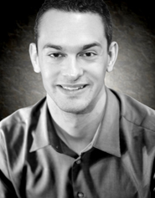
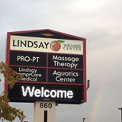
Physical Therapist
Required skills
Communication
Dependability
Responsibility
Intuitive
Is there a future for you in this field, especially after the job shadow?
Definitely, with the job shadow my decision was that much more clear to me
Dr. Stephen Lege

Slide 6
Senior Writing – 7 Modes
Topic: Physical Therapy
I chose physical therapy because I have experience with going to physical therapy and nothing else has ever grasped my attention like physical therapy. I love the thought of being able to help injured people get back to their normal lifestyles

Slide 7
Senior Writing Cont’d
The 7 modes:
Definition: define physical therapy and the various types
Description & Narration: narrate a story of mine related to physical therapy
Compare/Contrast: two different physical therapy programs at two different schools
Cause & Effect: the causes of the three most common injuries
Argument & Persuasion: persuading that some exercises are best for certain injuries
Classification/Division: classifying two types of physical therapy
Throughout writing these seven papers, I learned that there is a lot to physical therapy; however, while going through this, I am that much more intrigued by the field. I feel that through physical therapy, I will be able to help people in need and that is what I want to do within life, help people in need.

Slide 8
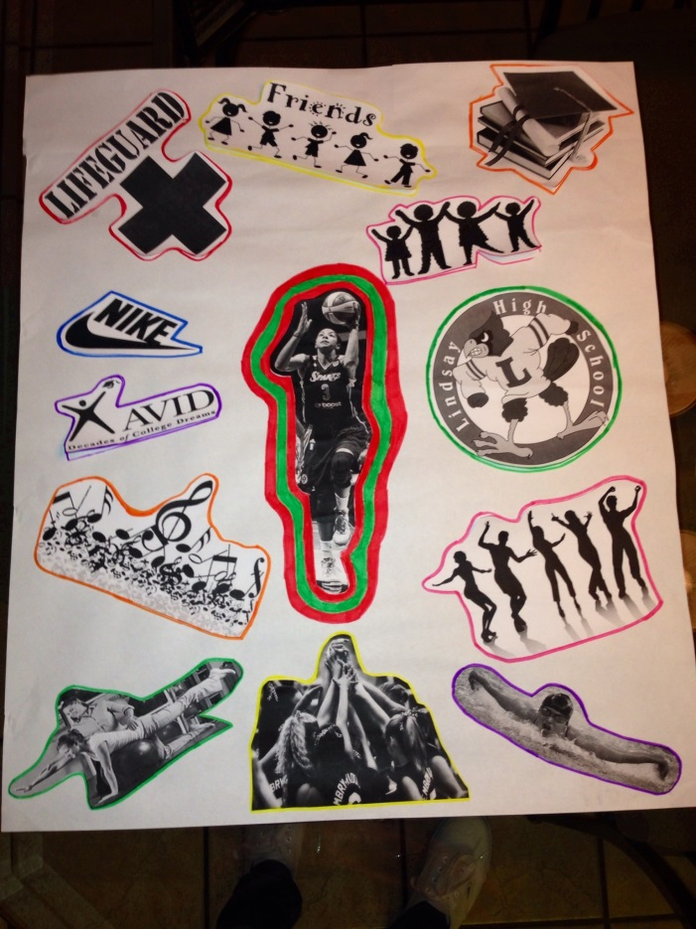
Visual Representation

Slide 9
My Future
Plan on attending a 4-year university in the fall
Possibly try walking on to a women’s college basketball team
Get an internship at a clinic or some type of physical therapy clinic

Slide 10
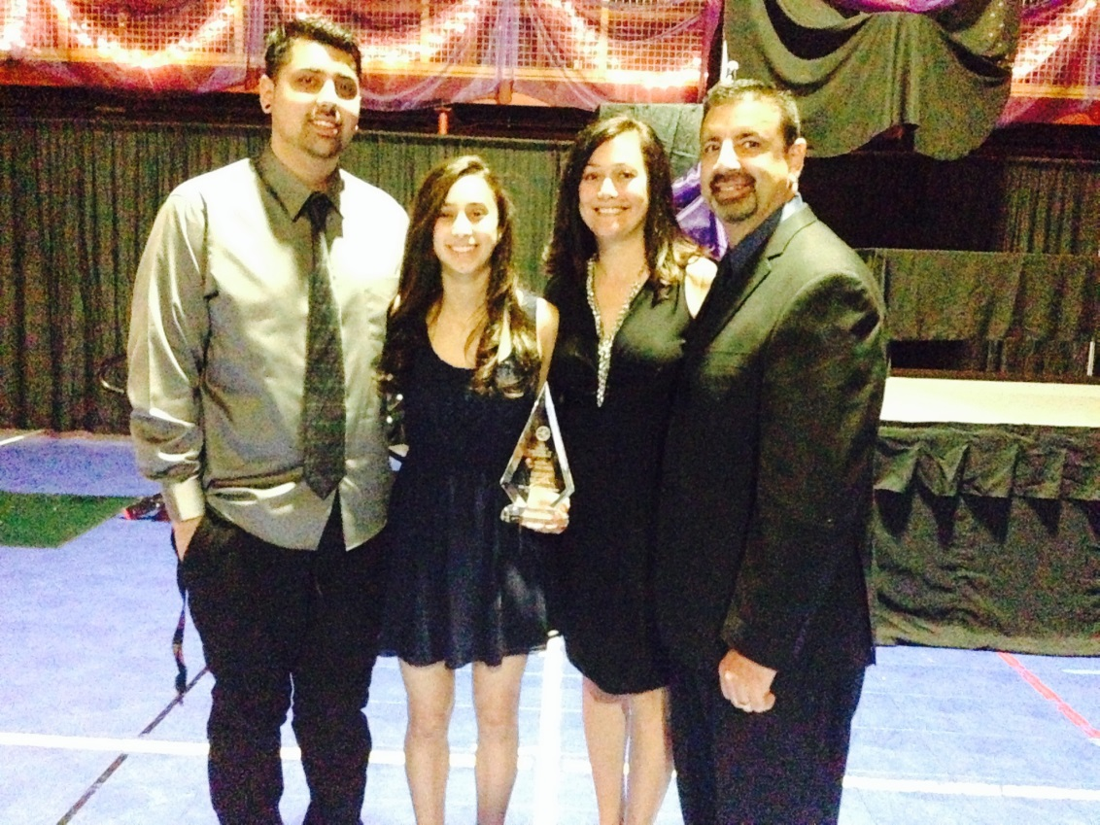
Thank You for your time!
You miss 100% of the shots you don’t take.
- Wayne Gretzky

